Slide 1

Graph Spanner Approximations
Sparse Distance-Preserving Subgraphs in Practice
Sheikh Muhammad Muneeb | Abdul Moiz | Ahmed Moosa Owais
Habib University | CS412 Algorithms: Design and Analysis

Slide 2

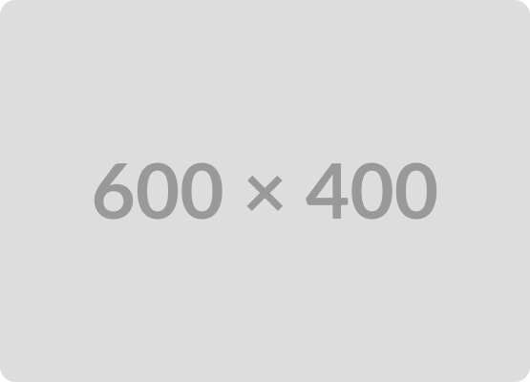

The Problem Definition
A spanner H is a sparse subgraph of G that preserves all pairwise distances within a multiplicative stretch factor alpha.
Optimization Challenge: Minimizing path stretch while maximizing sparseness (edge count) and lightness (total weight).

Slide 3



Algorithmic Contenders
Greedy ADDJS
Baswana-Sen
The Trade-off
Deterministic approach. Processes edges in non-decreasing weight order. Guarantees near-optimal lightness but requires high path-query overhead.
Randomized clustering algorithm. Operates in expected linear time O(kE). Efficient for massive graphs but provides no weight guarantees.
Greedy = High Quality, Low Scalability. Baswana-Sen = High Scalability, Variable Quality.

Slide 4
Methodology & Implementation
Stack: Python 3 with NetworkX for graph primitives and path queries.
Dijkstra Bottleneck: Greedy execution limited to n ≤ 500 due to pure Python interpreter overhead on complete graphs.
Variance Control: 10 independent trials executed for Baswana-Sen to isolate randomization effects.

Slide 5



Benchmark Dataset Suite
102
237
2
TSPLIB Instances
Steinlib Instances
SNAP Social Graphs
Dense metric graphs, filtered for valid symmetric properties (No ATSP/zero-weight).
Sparse grid and VLSI-derived instances testing bottleneck edge retention.
Facebook (ego) and Gnutella (P2P) for massive small-world scalability testing.
Total: 1,360 logical configurations evaluated.

Slide 6
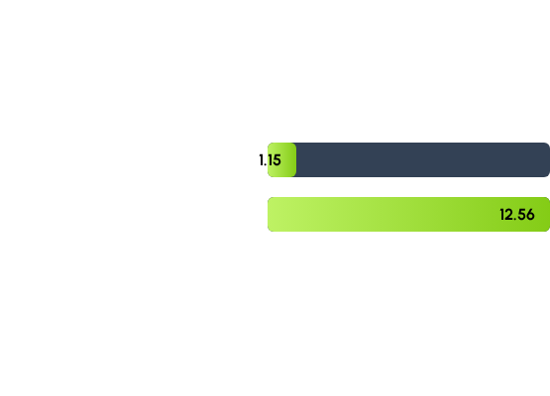
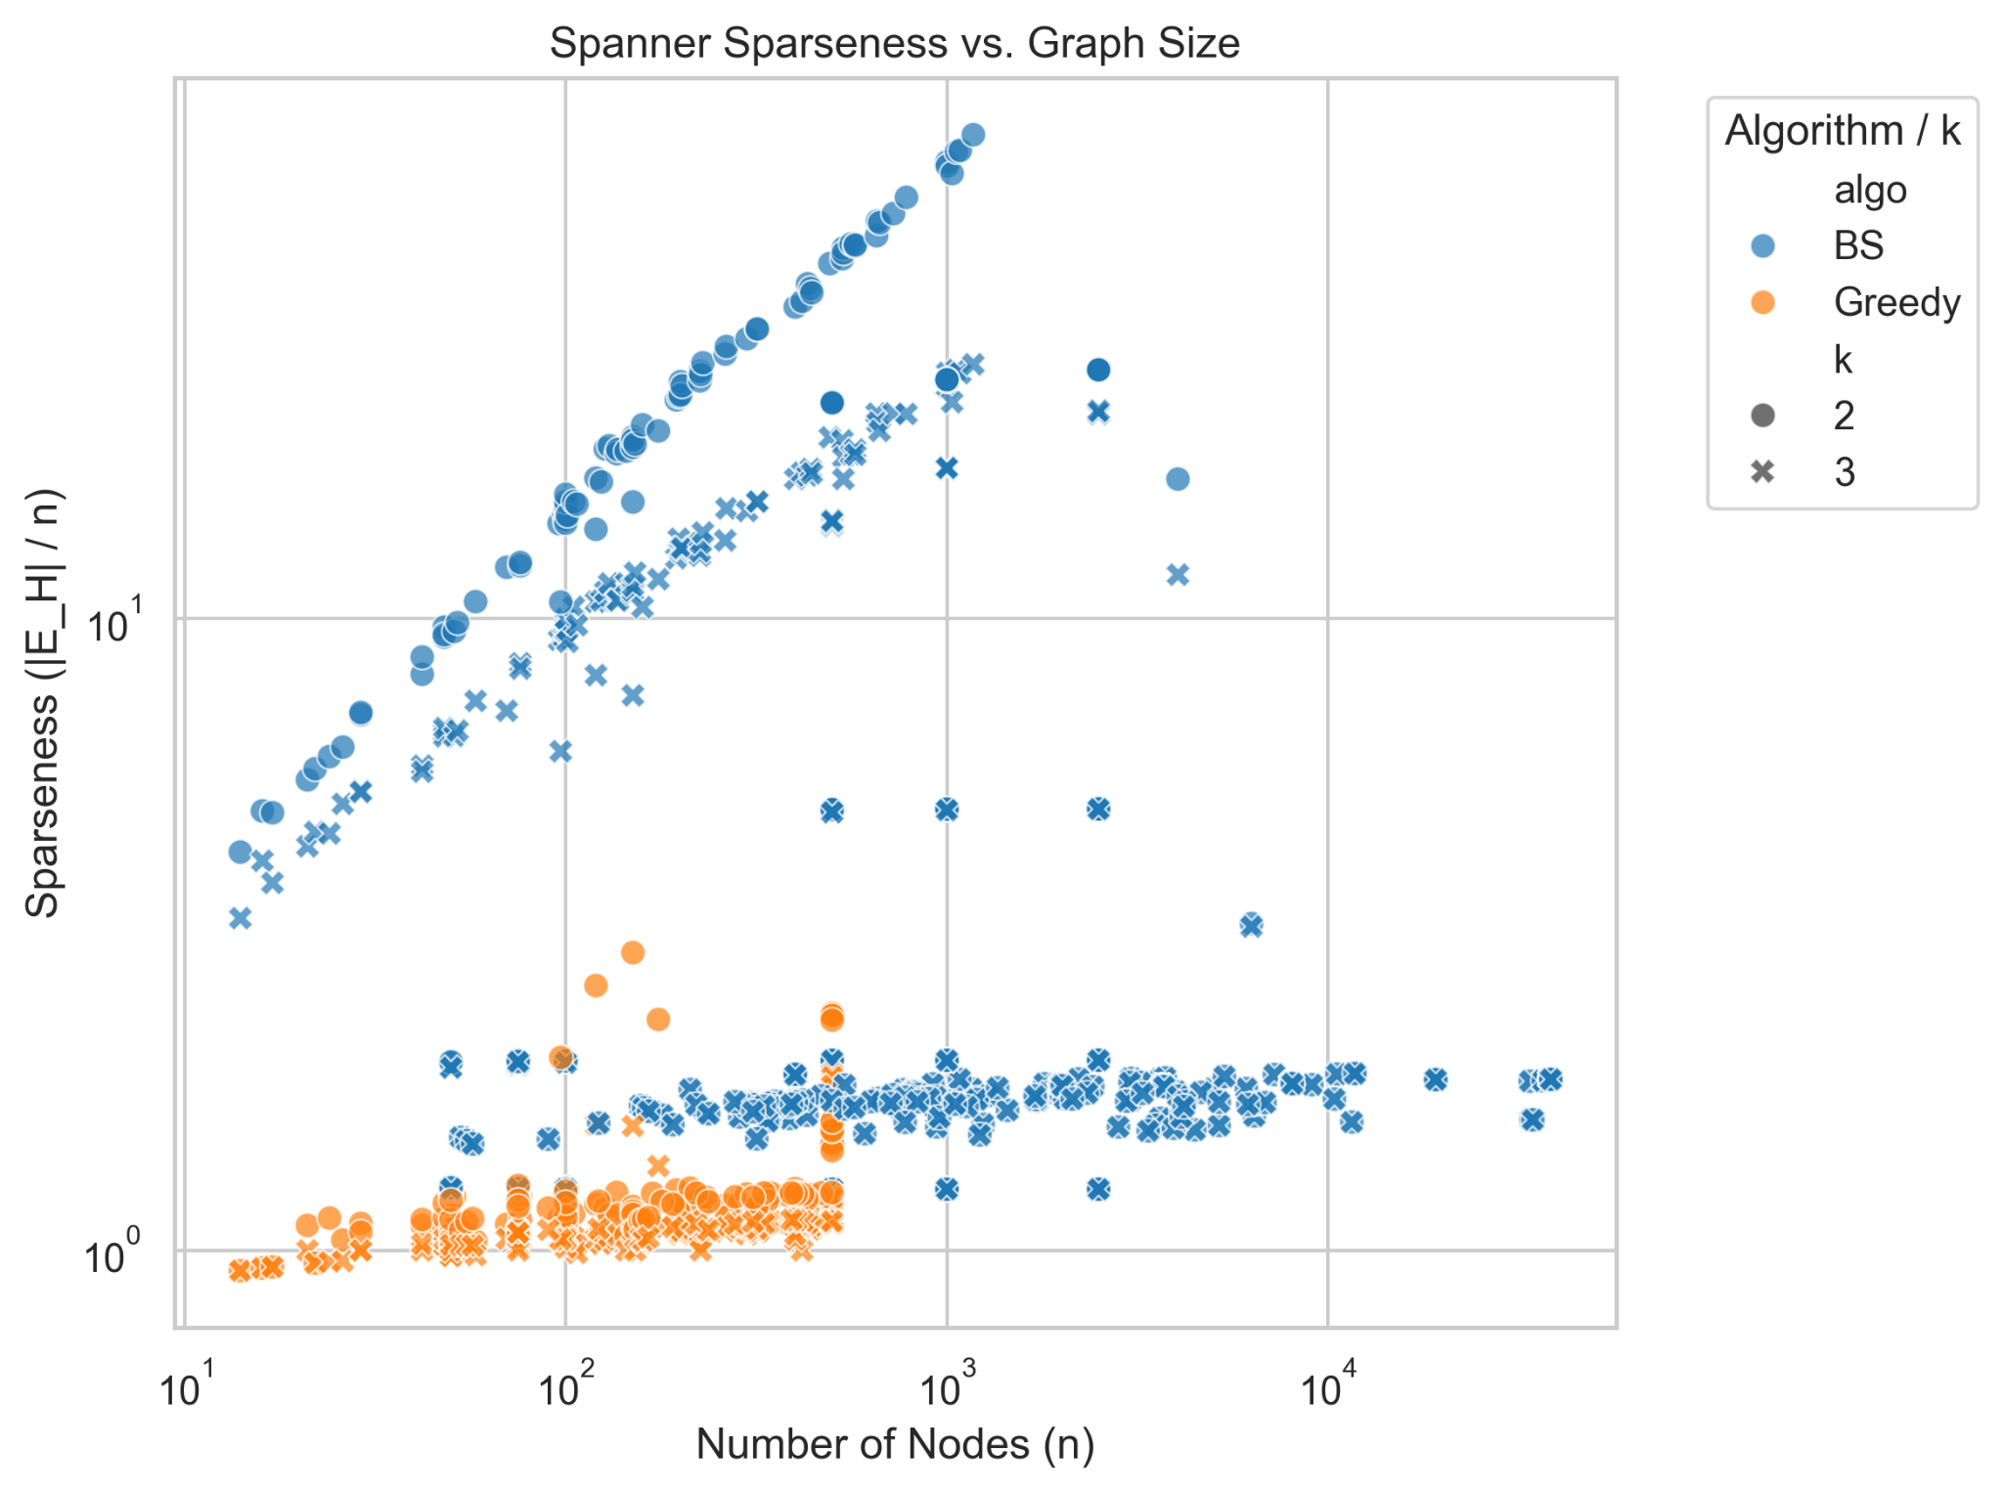
Results: Sparseness
Greedy strictly minimizes graph density, while Baswana-Sen retains significantly more redundant links due to randomized clustering.
Insight: BS is ~10.9x denser than Greedy on metric graphs.

Slide 7

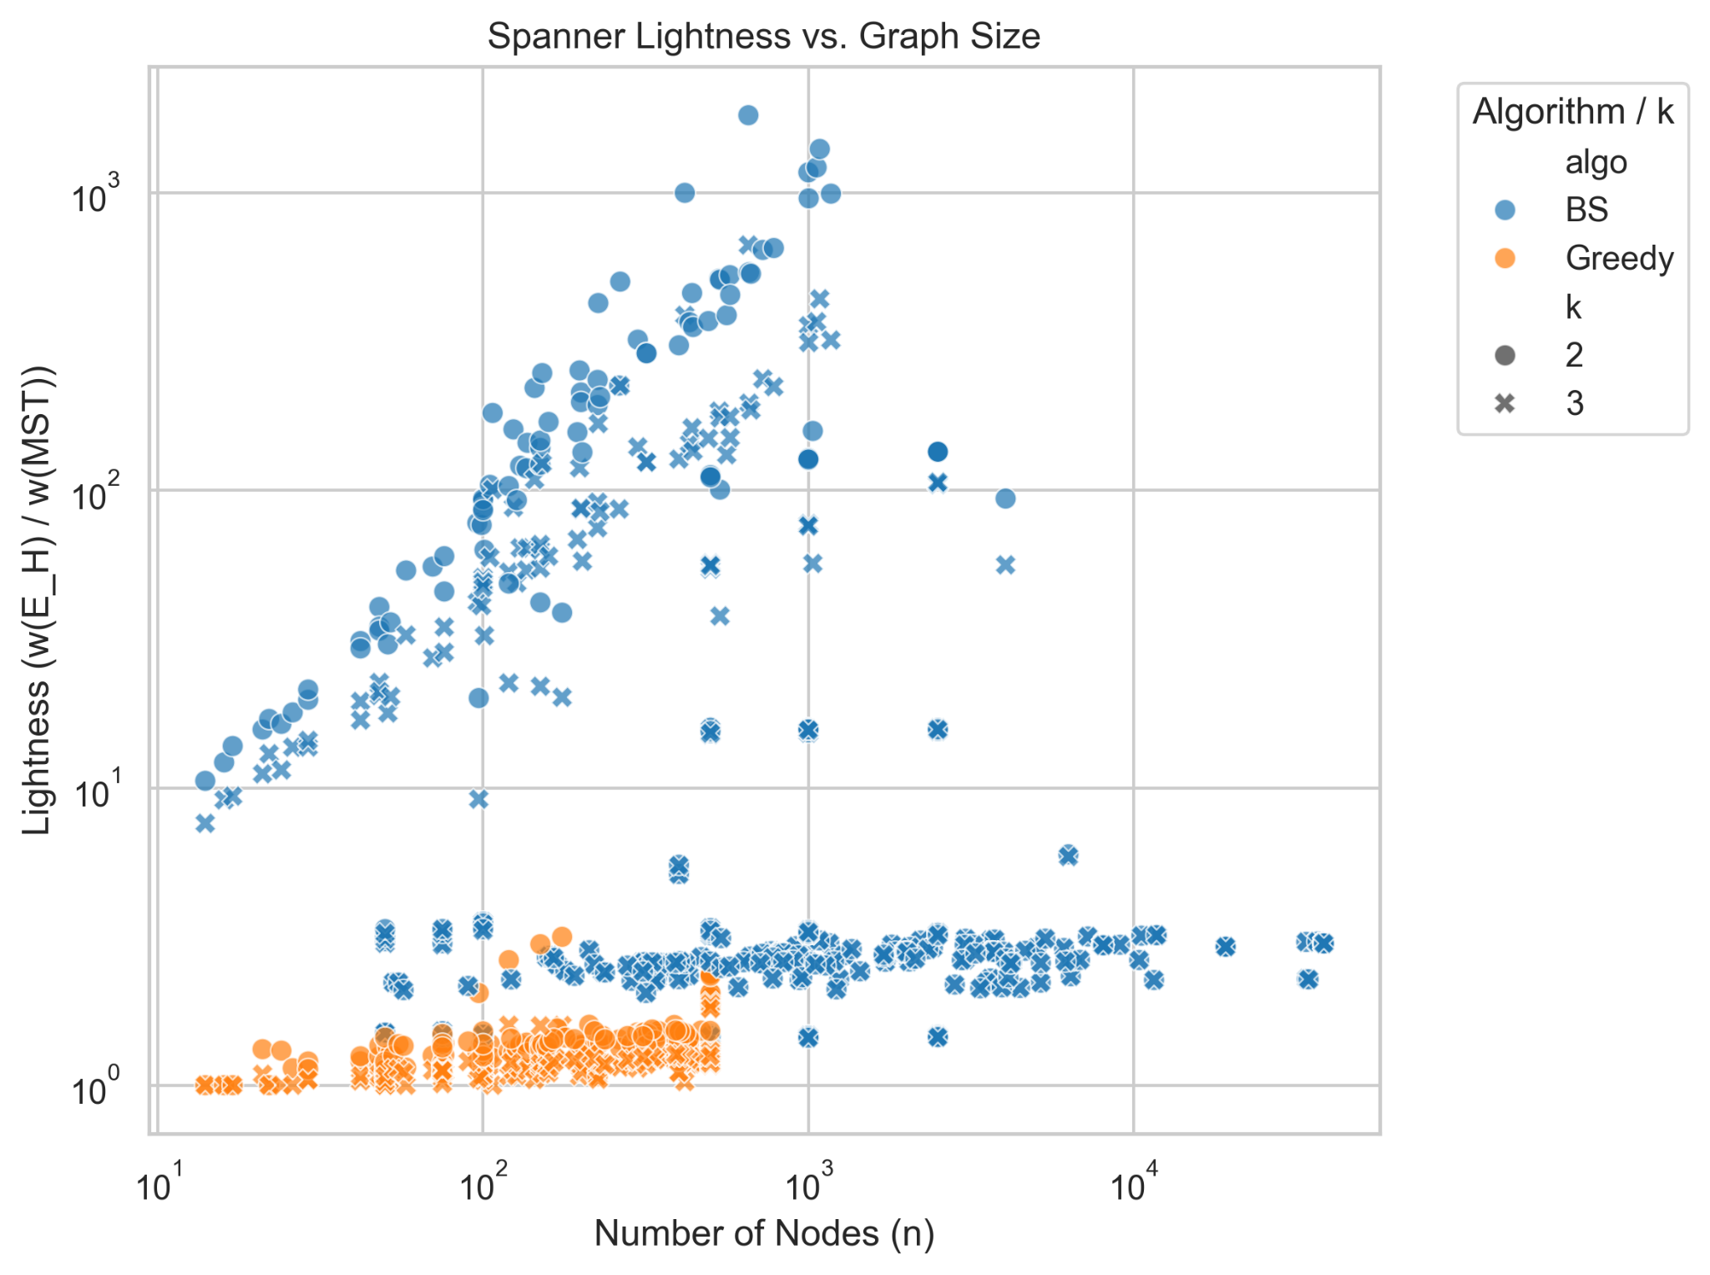
Results: The Lightness Paradox
Lightness evaluates spanner weight relative to the Minimum Spanning Tree (MST).
Greedy: Bounds weight near 1.3 across all topologies.
Baswana-Sen: Reaches 193.2 on complete graphs.
(89.7x heavier than Greedy's 1.22)
Critical Failure: BS lightness is a direct function of edge density; inviable for routing cost-minimization.

Slide 8
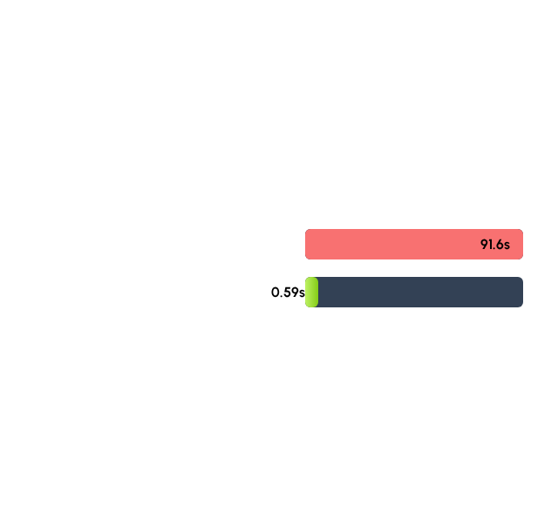
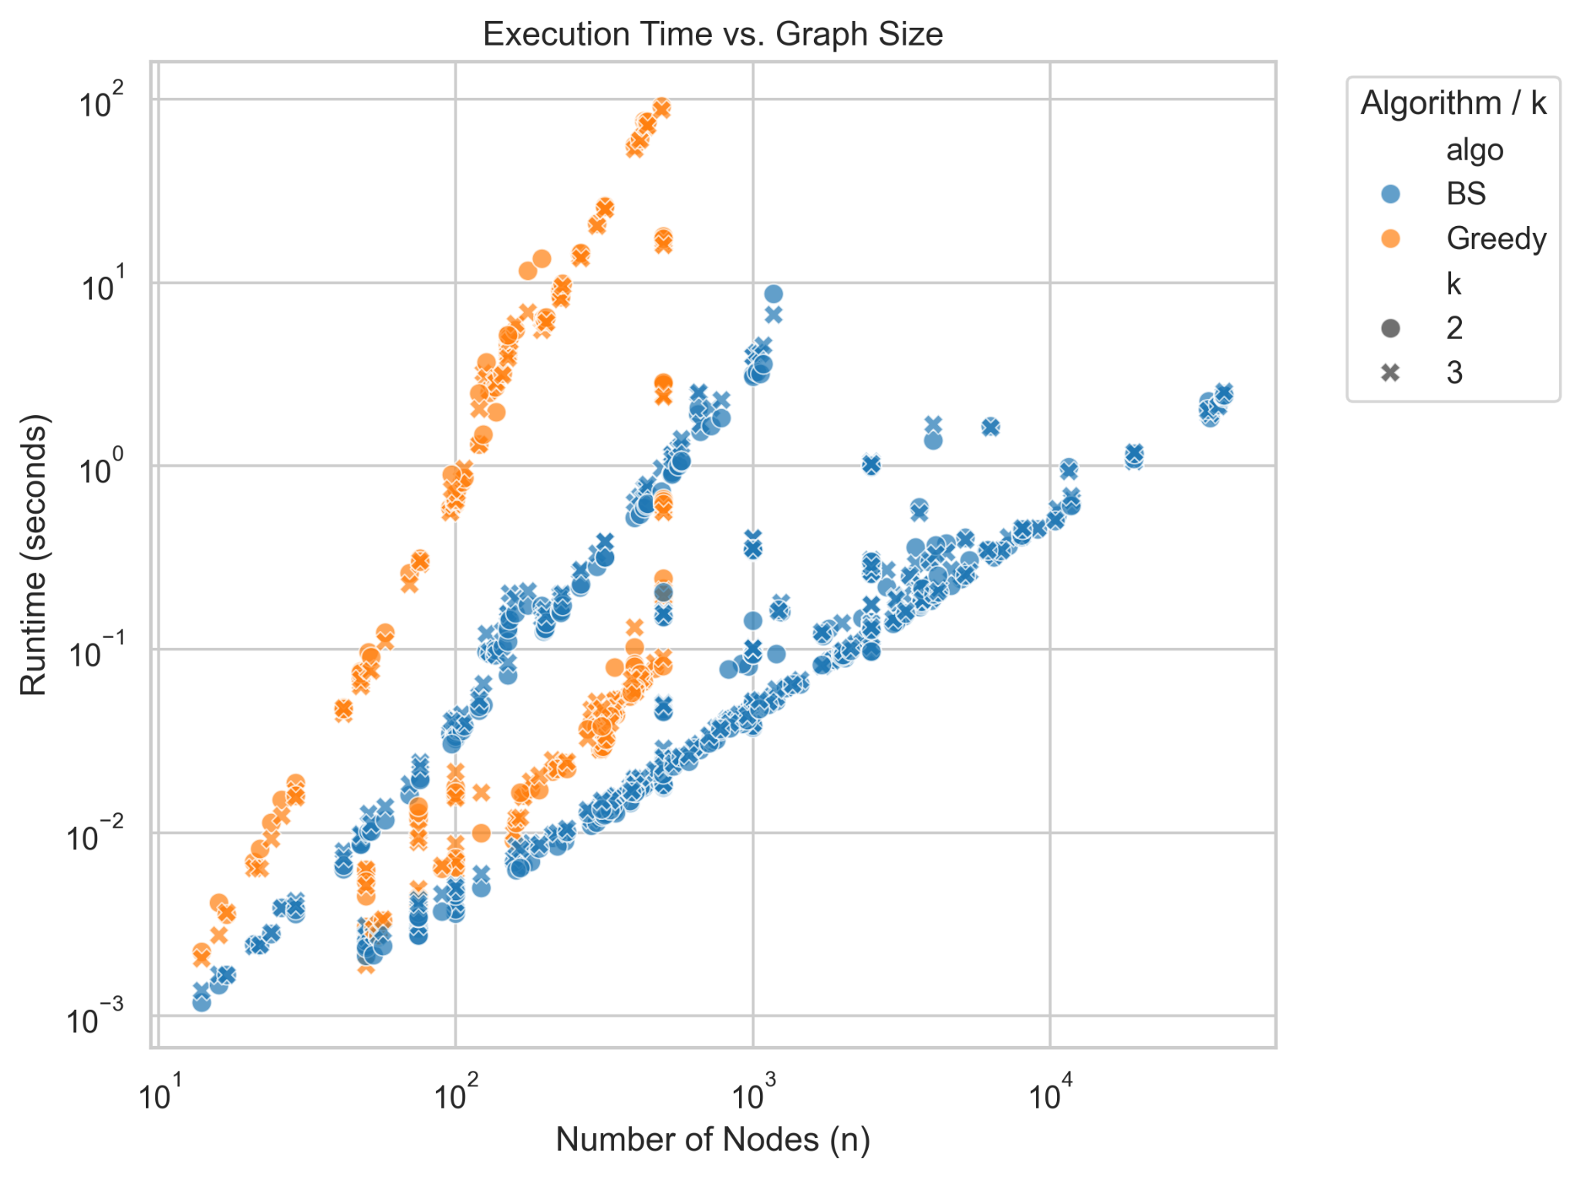
Runtime Scalability
The O(V4) bottleneck of Greedy vs the linear-time efficiency of Baswana-Sen Clustering.
Baswana-Sen is 33.7x faster on matched instances and successfully traverses 4,039 nodes in under 1.5 seconds.

Slide 9
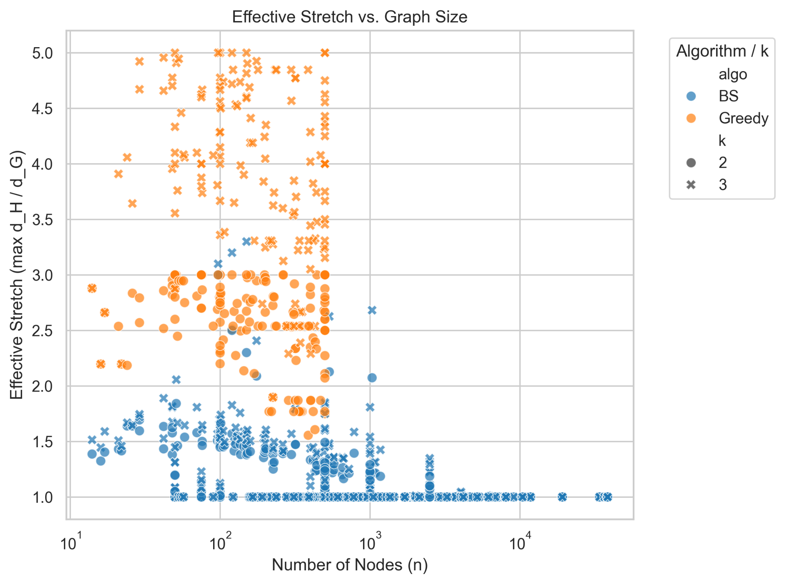


Effective Stretch
Measuring realized distance distortion vs theoretical bounds.
Greedy (3.35)
Utilizes full stretch budget to maximize edge rejection. Paths are volatile and push analytical ceilings.
Baswana-Sen (1.51)
Conservative results. Distance-oblivious clustering over-preserves topology, resulting in much lower stretch than allowed.

Slide 10






Project Limitations
Computational Cap
Dataset Scope
Stretch Oracles
Greedy limited to n ≤ 500. Pure Python Dijkstra queries induced hardware stalls beyond this boundary.
TSPLIB synchronization restricted to an 81-instance verified subset due to host server outages.
Reliance on 1,000-pair sampling for massive graphs introduces small statistical risk of missing worst-case stretch.

Slide 11
Key Insights
"There is no alternative to Greedy for applications requiring a lightness guarantee."
Greedy Dominates Quality: Best for network routing where weight translates to cost.
BS Dominates Scale: Necessary for P2P/Social network discovery where runtime is critical.

